Slide 1

Problem Solving Tactics

Slide 2
Steve Tauber
For hire?
Future Branch Development
Cuddli

Slide 3
What it is
Decision Making
Root Cause Analysis
5 Whys
Reasoning from First Principles
Others

Slide 4
What it isn’t
No silver bullet
Bite the bullet

Slide 5
5 Whys
Why
Why
Why
Why
Why

Slide 6
5 Whys - Example
Problem: Didn’t ship on time
Why?
Couldn’t finish all the features
Why?
There were too many features
Why?
Some features were added mid-sprint
Why?
The CTO has authority to change features mid-sprint
Why?

Slide 7

Story Time

Slide 8
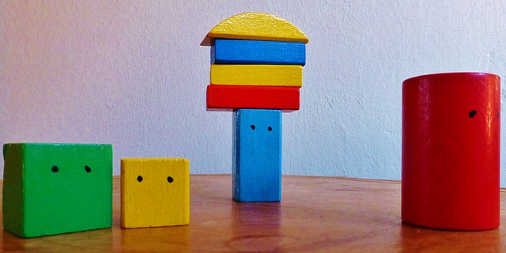

Slide 9


Slide 10


Slide 11
What do we know to be true?
Can we do both?
No
How long would a transition take?
2 years
How long will it take for them to catch up?
Too long

Slide 12
First Principles!
Can we do both?
No
How long would a transition take?
2 years
How long will it take for them to catch up?
Too long

Slide 13
Other RCA tactics
Rapid Problem Resolution (RPR)
Kepner-Tregoe Technique (KT)
Ishikawa (Fishbone)
Notes:
RPR – process for IT, one symptom
KT – situation, problem, action, risk
Fish - Analysis of all factors

Slide 14
Problem Distillation (Tree Pruning)
Use Hypotheticals
Distil the problem
Search for matching branches
Prune
Notes:
RPR – process for IT, one symptom
KT – situation, problem, action, risk
Fish - Analysis of all factors

Slide 15
Questions?

Slide 16
Photo Credits
Story - https://medium.com/@mmccue/the-most-powerful-lesson-i-ve-ever-learned-in-business-4d89e95ab250
https://www.flickr.com/photos/29233640@N07/13265854343
http://maxpixel.freegreatpicture.com/static/photo/1x/Building-Blocks-Build-Colorful-Tower-Play-456614.jpg
https://www.pexels.com/photo/blue-cloudy-sky-86695/

